Slide 1
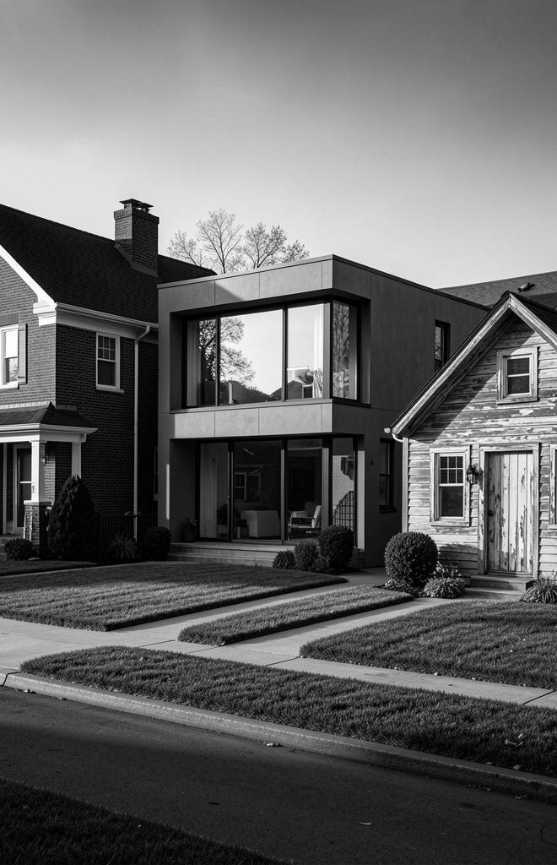
HOUSE PRICE PREDICTION SYSTEM
Predictive system for real estate valuations using
machine learning regression techniques

Slide 2

OBJECTIVE
- Predict house prices using machine learning
- Apply feature engineering techniques
- Compare multiple regression models
- Select best-performing model
- Build a working prediction system

Slide 3

REAL-TIME STATISTICS RELATED TO THE PROJECT
- Real estate prices are increasing every year
- Property value depends on location, area, and amenities
- Manual estimation often leads to errors
- ML-based systems improve prediction accuracy

Slide 4
MOTIVATION
- Difficulty in estimating accurate house prices
- Need for fast and data-driven solutions
- Reduce human error in decision making
- Provide smart assistance for buyers and sellers

Slide 5
EXISTING SYSTEMS
- Manual estimation by agents
- Basic online price calculators
- Fixed rule-based systems

Slide 6
ISSUES IN EXISTING SYSTEMS
- Not accurate
- Depends on human judgment
- Cannot handle complex data
- No adaptability to new data

Slide 7

PROPOSED SYSTEM
- Machine learning-based prediction system
- Uses multiple features (area, location, etc.)
- Applies feature engineering
- Compares models and selects best one
- Provides accurate price prediction

Slide 8
COMPARISON OF EXISTING VS PROPOSED SYSTEM
- Existing systems have low accuracy, whereas the proposed system provides high accuracy.
- Existing systems offer medium speed, while the proposed system is faster.
- Existing systems have limited data handling capabilities, whereas the proposed system can handle data more efficiently.
- Existing systems are not automated, while the proposed system is fully automated using machine learning.

Slide 9
SAMPLE INPUT / OUTPUT
Input:
- Area: 1500
- Bedrooms: 3
- Age: 5
- Distance: 10
- Schools: 8
- Location: Urban
Output:
- Predicted Price: ₹5,50,000 (approx.)

Slide 10
TOOLS AND DATASET USED
- Programming Language: Python
- Libraries: Pandas, NumPy, Scikit-learn
- Framework: Flask
- Dataset: Kaggle House Price Dataset

Slide 11
RESULTS AND ANALYSIS
- Random Forest performed best
- Feature engineering improved accuracy
- Model shows low prediction error
- Works effectively for different regions

Slide 12
REFERENCES
- Kaggle Dataset:
- https://www.kaggle.com/datasets/harlfoxem/housesalesprediction
- Scikit-learn Documentation:
- https://scikit-learn.org/stable/
- Machine Learning Book:
- https://www.oreilly.com/library/view/hands-on-machine-learning/9781492032632/

